Slide 1
Review: Simulation Code
Evaluate Multi-core Architectures
Seunghyun Beak

Slide 2
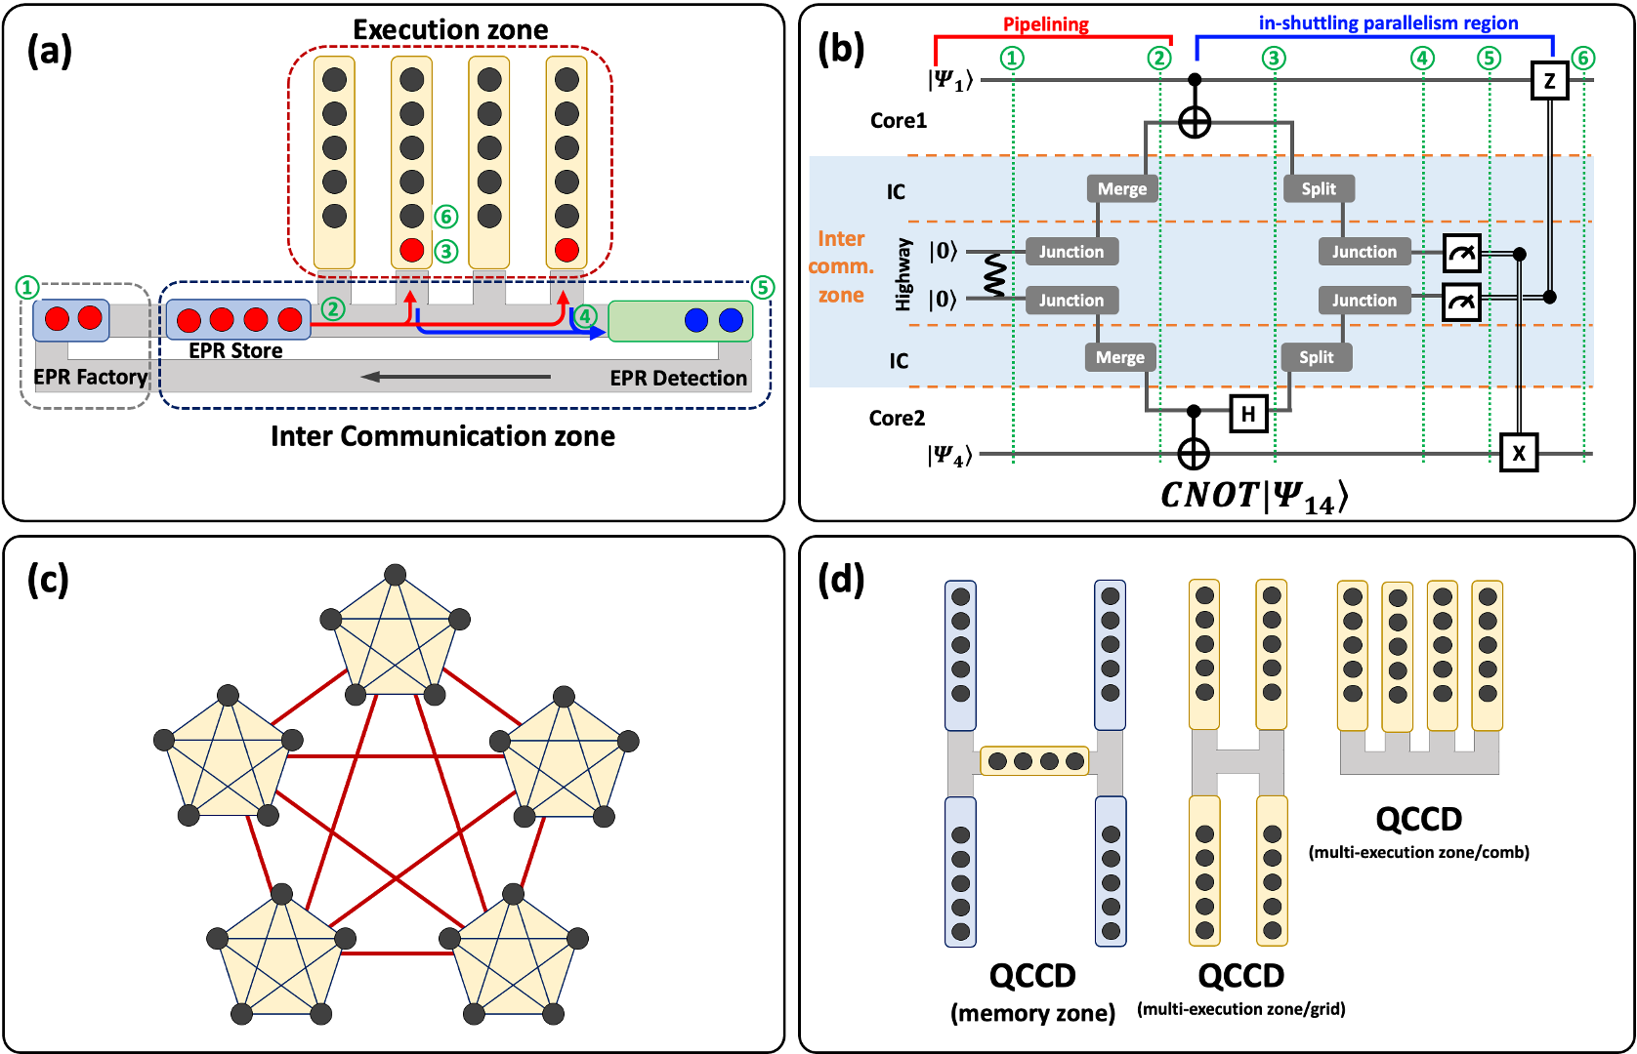
1. Model

Slide 3
2. Code Structure
사용 언어 : Julia
Github: https://github.com/Seunghyun100/simulator
INPUT
Configuration Modules
architecture_configuration.json
operation_configuration.json
communication_configuration.json
architecture_configuration.jl
operation_configuration.jl
communication_configuration.jl
mapper.jl
circuit.json
circuit_builder.jl
RESULT
communication_protocol.json
communication_protocol.jl
simulator.jl

Slide 4
2. Code Structure
Configuration
Architecture: Generate architecture according to input json contained topology, core capacity etc.
Operation: operation duration, fidelity etc.
Communication: Shuttling duration, heating rate etc.
Communication Protocol: drawing shuttling path, checking communication qubit etc.
Mapping: one-to-one mapping to physical qubit from circuit qubit (NOT optimized, Simply mapping)
Simulator
run: start simulator
executeCircuit: execute the input circuit with counting reference time and loop
evaluateResult: evaluate the circuit result (execution time, heating rate, shuttling number)
printResult: print result
in while execute
checkNeedCommunication: If true -> Shuttling
checkEndOperation: check reference time > qubit time. If true -> execute next operation
executeOperation: check the operation type. If 2-qubit gate -> checkNeedCommunication. “execute” is adding gate duration to qubit time.
In QCCD: If prepared shuttling but during the other shuttling -> dwell time
executeShuttlingByLayer: execute all prepared shuttling at once (Only Q-bus)

Slide 5
3. Assumption
Common
without Compiler Optimization
without considering commute
all one-qubit gate can be parallel
QCCD
Symmetric configuration: going and returning shuttling
unlimited core capacity
only one qubit shuttling at once
Q-bus
complete pipelining up to merging target core
always layer shuttling

Slide 6
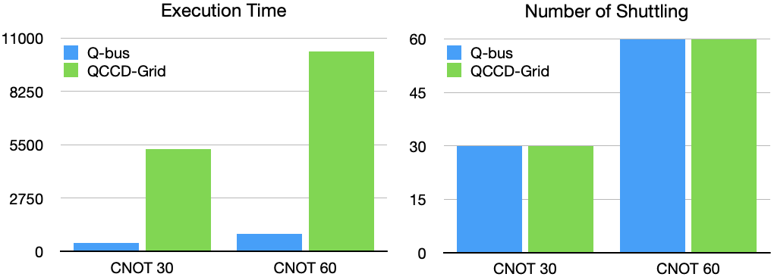
4. Test Circuit
q30
30
q30
30
30
q30
q30
30
30
30
CNOT 30
CNOT 60

Slide 7
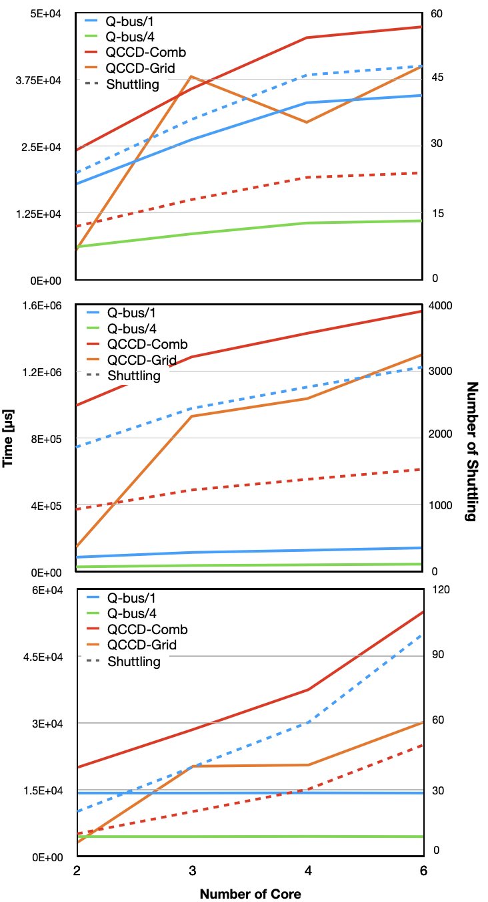
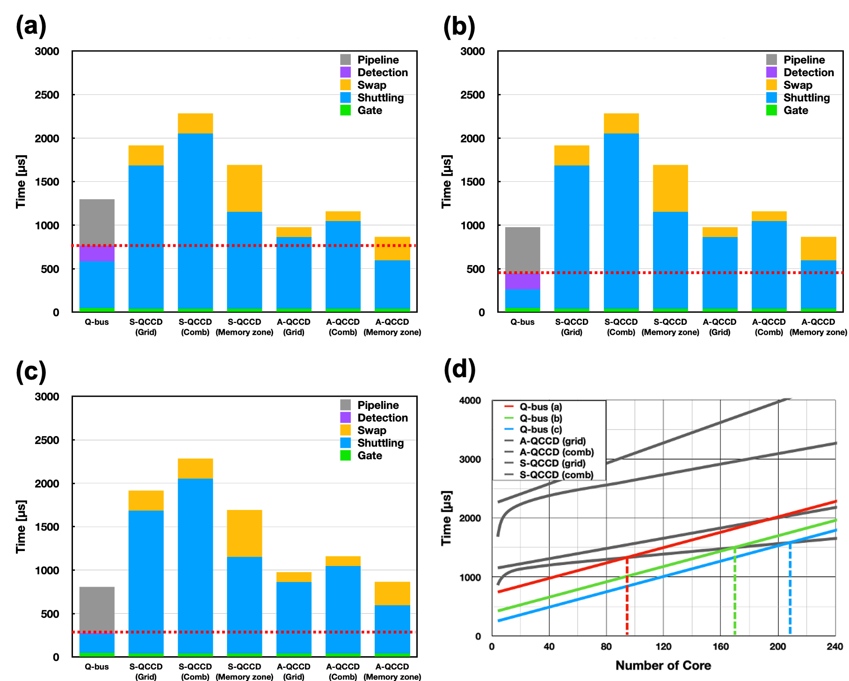
5. Simulation Results – Execution Time

Slide 8
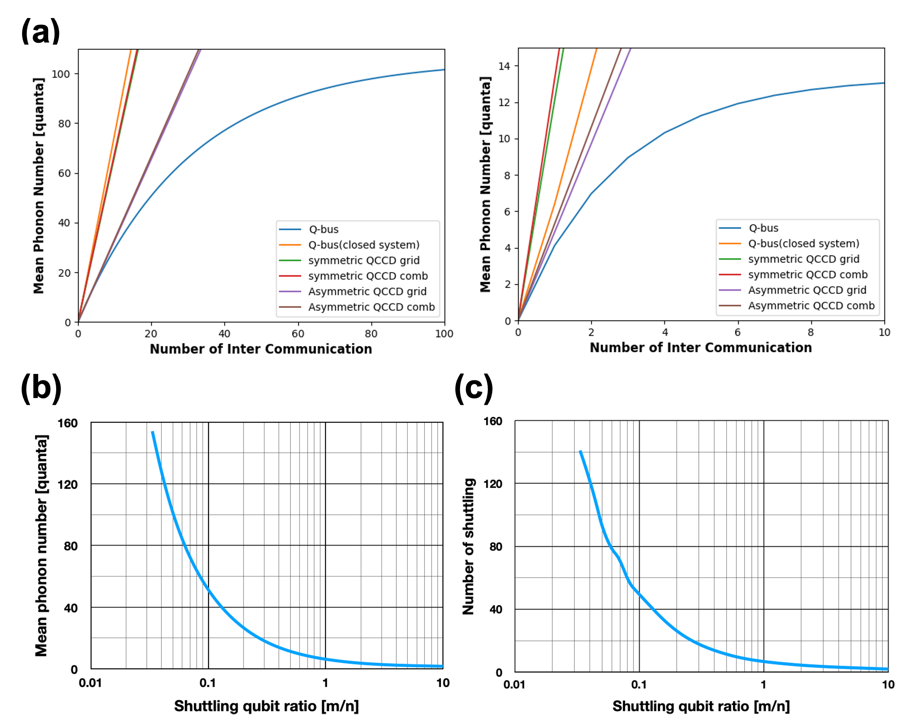
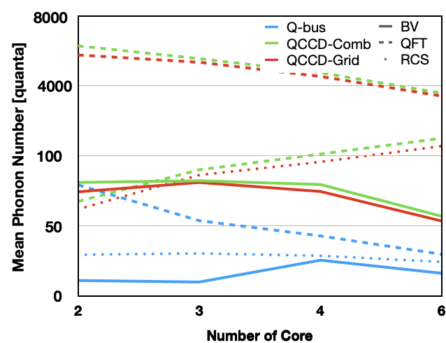
5. Simulation Results – Heating Rate
(a)
(b)
(c)
(d)

